Slide 1
Perancangan Sistem Pemrograman
UML Interaction Diagrams
Prepared by Frans Panduwinata, S.Kom, M.T

Slide 2
Interaction Diagrams
Illustrates the message interactions between instances (and classes) in the class model.
UML defines two kinds of interaction diagrams:
  Sequence diagrams
  Collaboration diagrams

Slide 3
Sequence Diagram
What is a UML Sequence Diagram?
Sequence diagrams describe interactions among classes in terms of an exchange of messages over time.
The main purposes of a sequence diagram is to define event sequences that result in some desired outcome.

Slide 4
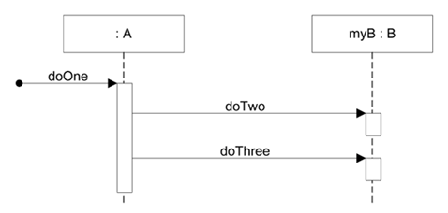
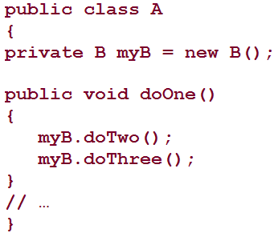
Sequence Diagram (cont)
EXAMPLE:
Code mapping or generation
rules will vary depending on
the OO language

Slide 5
Collaboration Diagram
A Collaboration diagram is very similar to a Sequence diagram in the purpose it achieves.
A distinguishing feature of a Collaboration diagram is that it shows the objects and their association with other objects in the system apart from how they interact with each other.
The association between objects is not represented in a Sequence diagram.

Slide 6
Collaboration Diagram (cont)
A Collaboration diagram is easily represented by modeling objects in a system and representing the associations between the objects as links.
The interaction between the objects is denoted by arrows.
To identify the sequence of invocation of these objects, a number is placed next to each of these arrows.

Slide 7
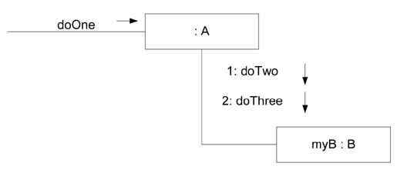
Collaboration Diagram (cont)
EXAMPLE:

Slide 8
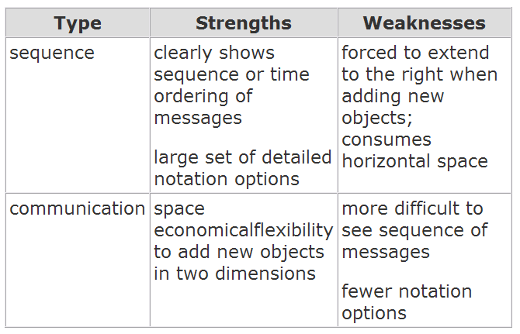
Sequence vs. Communication Diagrams
What are the Strengths and Weaknesses of Sequence vs. Communication Diagrams?

Slide 9
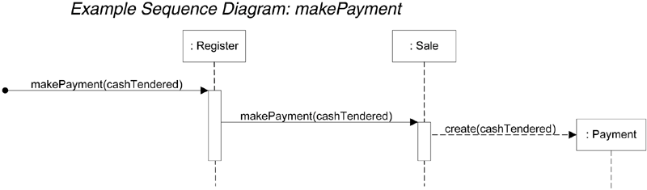
Example Sequence Diagram: makePayment
The sequence diagram shown above is read as follows:
  The message makePayment is sent to an instance of a Register. The sender is not identified.
  The Register instance sends the makePayment message to a Sale instance.
  The Sale instance creates an instance of a Payment.

Slide 10
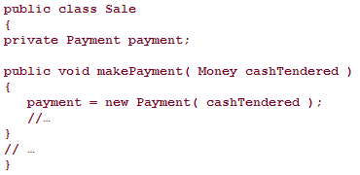
Example Sequence Diagram: makePayment (cont)
What might be some related code for the Sale class and its makePayment method?

Slide 11
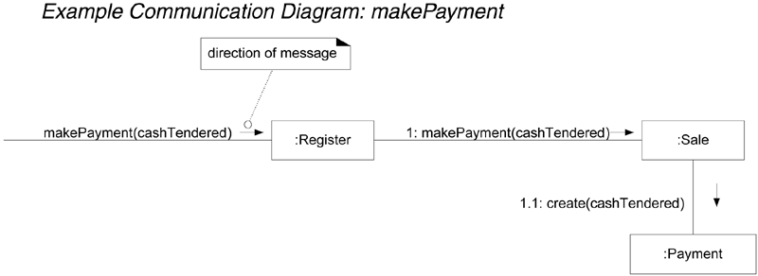
Example Collaboration Diagram: makePayment

Slide 12
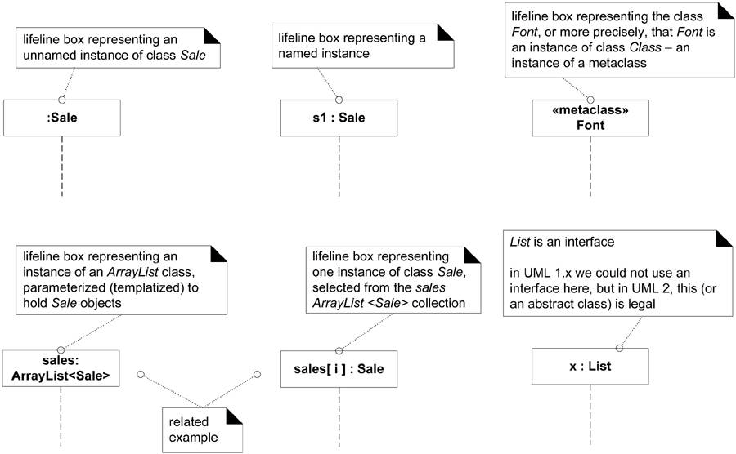
Basic Sequence Diagram Notation
Lifeline Boxes and Lifelines

Slide 13
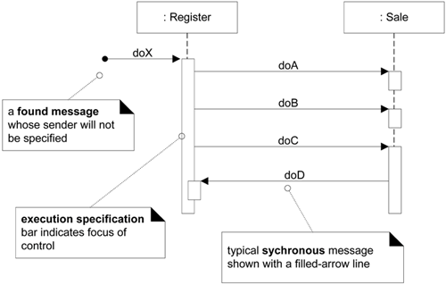
Basic Sequence Diagram Notation (cont)
Messages

Slide 14
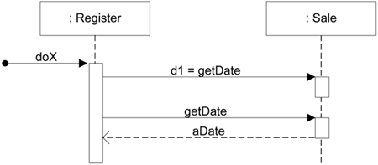
Basic Sequence Diagram Notation (cont)
Illustrating Reply or Returns
There are two ways to show the return result from a message:
  Using the message syntax returnVar = message(parameter).
  Using a reply (or return) message line at the end of an activation bar.

Slide 15
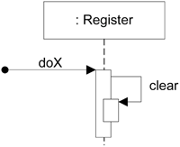
Basic Sequence Diagram Notation (cont)
Messages to "self" or "this“
You can show a message being sent from an object to itself by using a nested activation bar

Slide 16
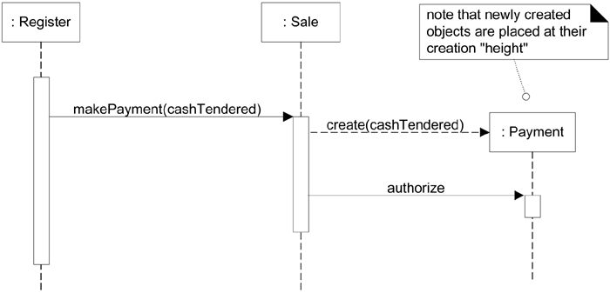
Basic Sequence Diagram Notation (cont)
Creation of Instances

Slide 17
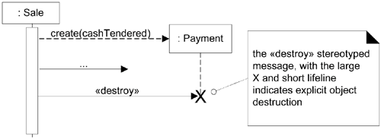
Basic Sequence Diagram Notation (cont)
Object Lifelines and Object Destruction
In some circumstances it is desirable to show explicit destruction of an object.

Slide 18
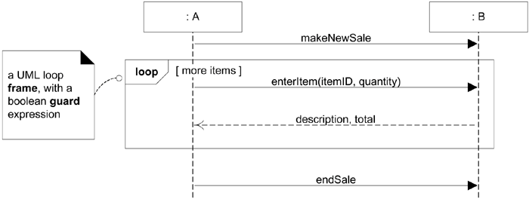
Basic Sequence Diagram Notation (cont)
Diagram Frames in UML Sequence Diagrams
The LOOP (Loop fragment while guard(conditional clause) is true) frame notation to show looping.

Slide 19
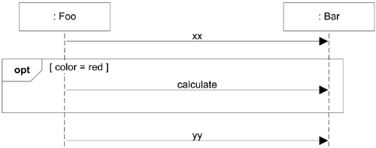
Basic Sequence Diagram Notation (cont)
Conditional Messages
An OPT (Optional fragment that executes if guard is true) frame is placed around one or more messages.

Slide 20
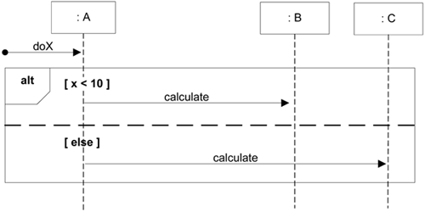
Basic Sequence Diagram Notation (cont)
Mutually Exclusive Conditional Messages
An ALT (Alternative fragment for mutual exclusion conditional logic expressed in the guards) frame is placed around the mutually exclusive alternatives.

Slide 21
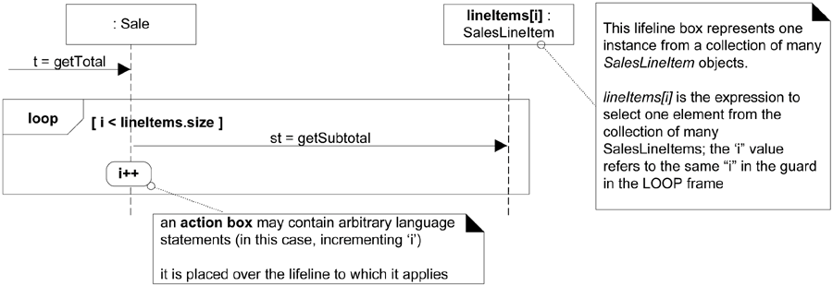
Basic Sequence Diagram Notation (cont)
Iteration Over a Collection
  Iteration over a collection using relatively explicit notation.
  Note the selector expression lineItems[i] in the lifeline of Figure above.
  The selector expression is used to select one object from a group.
  Lifeline participants should represent one object, not a collection.

Slide 22
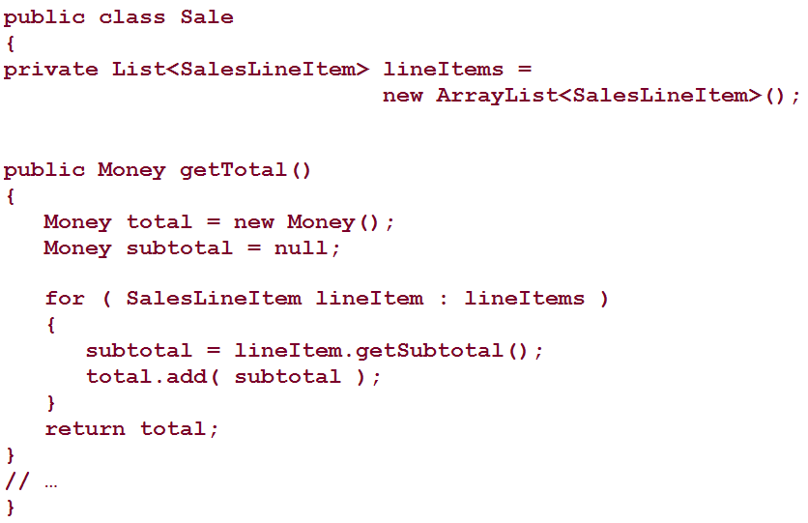
Basic Sequence Diagram Notation (cont)
Iteration Over a Collection (cont)
In Java, for example, the following code listing is a possible implementation that maps the explicit use of the incrementing variable i in previous figure.

Slide 23
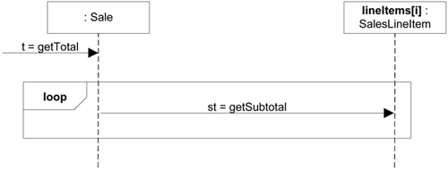
Basic Sequence Diagram Notation (cont)
Iteration Over a Collection (cont)
  Iteration over a collection leaving things more implicit (details are excluded).

Slide 24
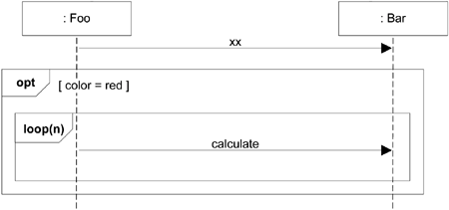
Basic Sequence Diagram Notation (cont)
Nesting of Frames
Frames can be nested.

Slide 25
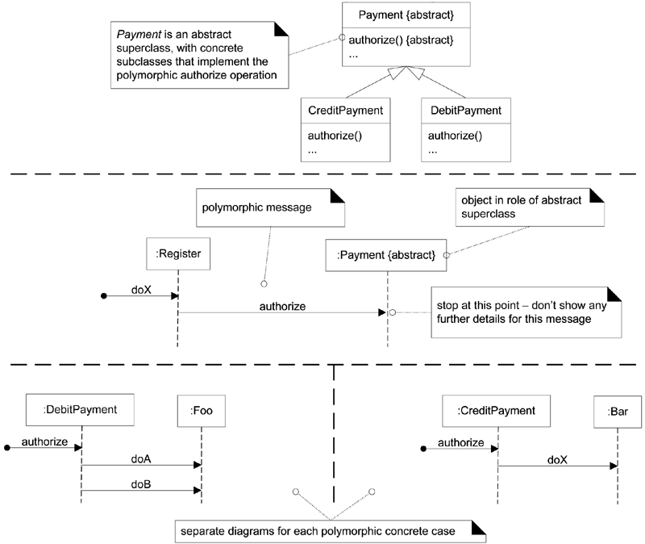
Basic Sequence Diagram Notation (cont)
Polymorphic
Messages and
Cases

Slide 26
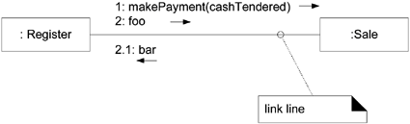
Basic Communication Diagram Notation
Links
A link is a connection path between two objects; it indicates some form of navigation and visibility between the objects is possible.

Slide 27
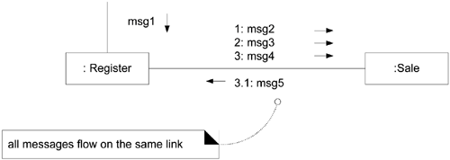
Basic Communication Diagram Notation (cont)
Messages
Each message between objects is represented with a message expression and small arrow indicating the direction of the message.

Slide 28
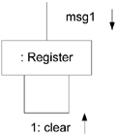
Basic Communication Diagram Notation (cont)
Messages to "self" or "this“
A message can be sent from an object to itself.

Slide 29
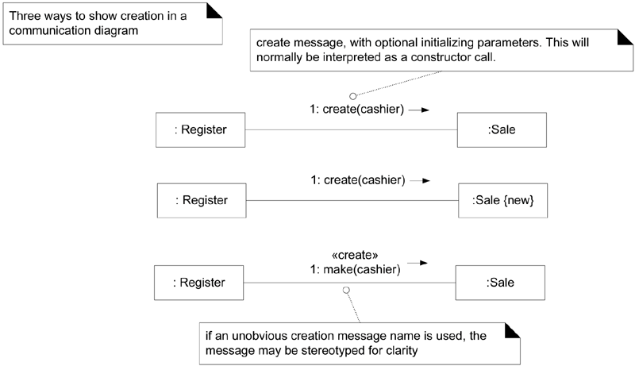
Basic Communication Diagram Notation (cont)
Creation of Instances

Slide 30
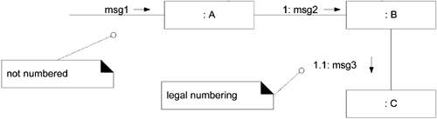
Basic Communication Diagram Notation (cont)
Message Number Sequencing
  Sequence numbering.

Slide 31
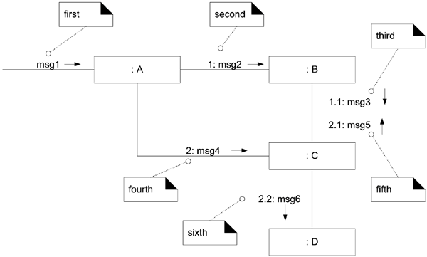
Basic Communication Diagram Notation (cont)
Message Number Sequencing (cont)
  Complex sequence numbering.

Slide 32
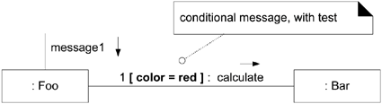
Basic Communication Diagram Notation (cont)
Conditional Messages
You show a conditional message by following a sequence number with a conditional clause in square brackets, similar to an iteration clause. The message is only sent if the clause evaluates to true.

Slide 33
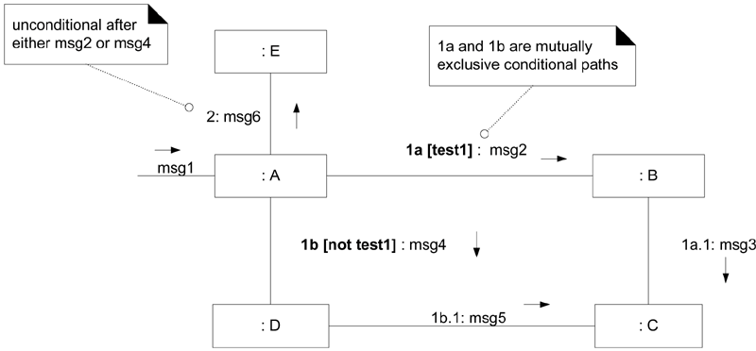
Basic Communication Diagram Notation (cont)
Mutually Exclusive Conditional Paths

Slide 34
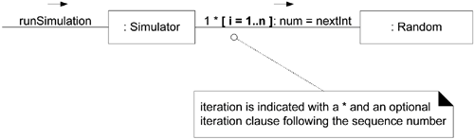
Basic Communication Diagram Notation (cont)
Iteration or Looping

Slide 35
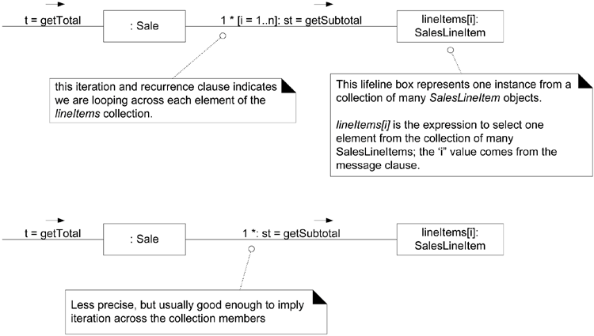
Basic Communication Diagram Notation (cont)
Iteration Over a Collection

Slide 36
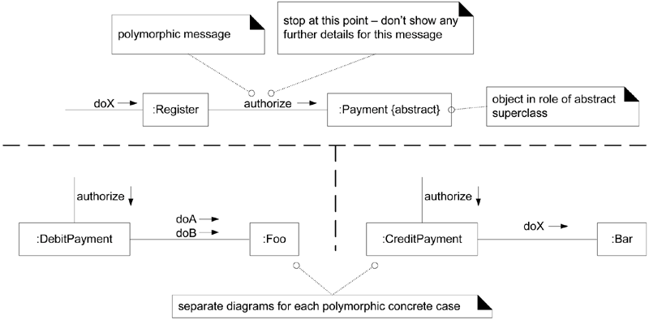
Basic Communication Diagram Notation (cont)
Polymorphic Messages and Cases

Slide 37
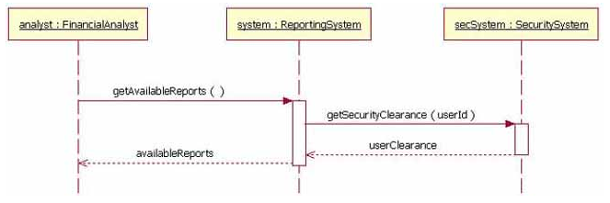
Examples
An EXAMPLE of messages being sent between objects
  The analyst object makes a call to the system object which is an instance of the ReportingSystem class.
  The analyst object is calling the system object's getAvailableReports method.
  The system object then calls the getSecurityClearance method with the argument of userId on the secSystem object, which is of the class type SecuritySystem.

Slide 38
Case Study
We had defined the following use cases for the Courseware Management System:
  View courses
  Manage topics for a course
  Manage course information
  View course calendar
  View tutors
  Manage tutor information
  Assign courses to tutors

Slide 39
Case Study (cont)
The "Manage course information" flow contains one participant: the Course Administrator.
There are a few entities with which the course administrator interacts in this flow—Course, Topic, and Tutor.

Slide 40
Case Study (cont)
The sequence of steps carried out in the "Manage course information" flow are:
  A user who is a course administrator invokes the manage course functionality.
  The manage course functionality of the course administrator invokes either the course creation or course modification functionality of a course.
  After the course is either created or modified, the manage topic functionality of the course administrator calls the topic creation or modification functionality of a topic.
  Finally, the user invokes the assign tutor to course functionality of the course administrator to assign a tutor to the selected course.

Slide 41
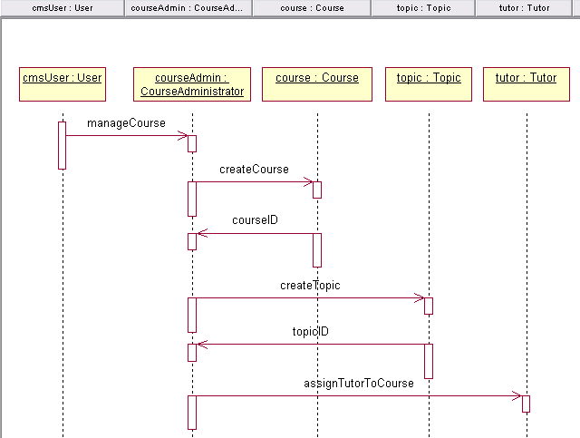
Case Study (cont)
Sequence diagram of Courseware Management System

Slide 42
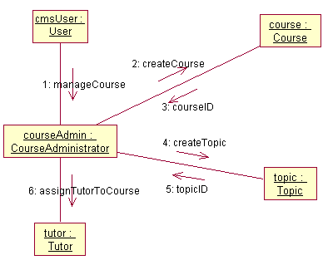
Case Study (cont)
Collaboration diagram of Courseware Management
System

